Slide 1
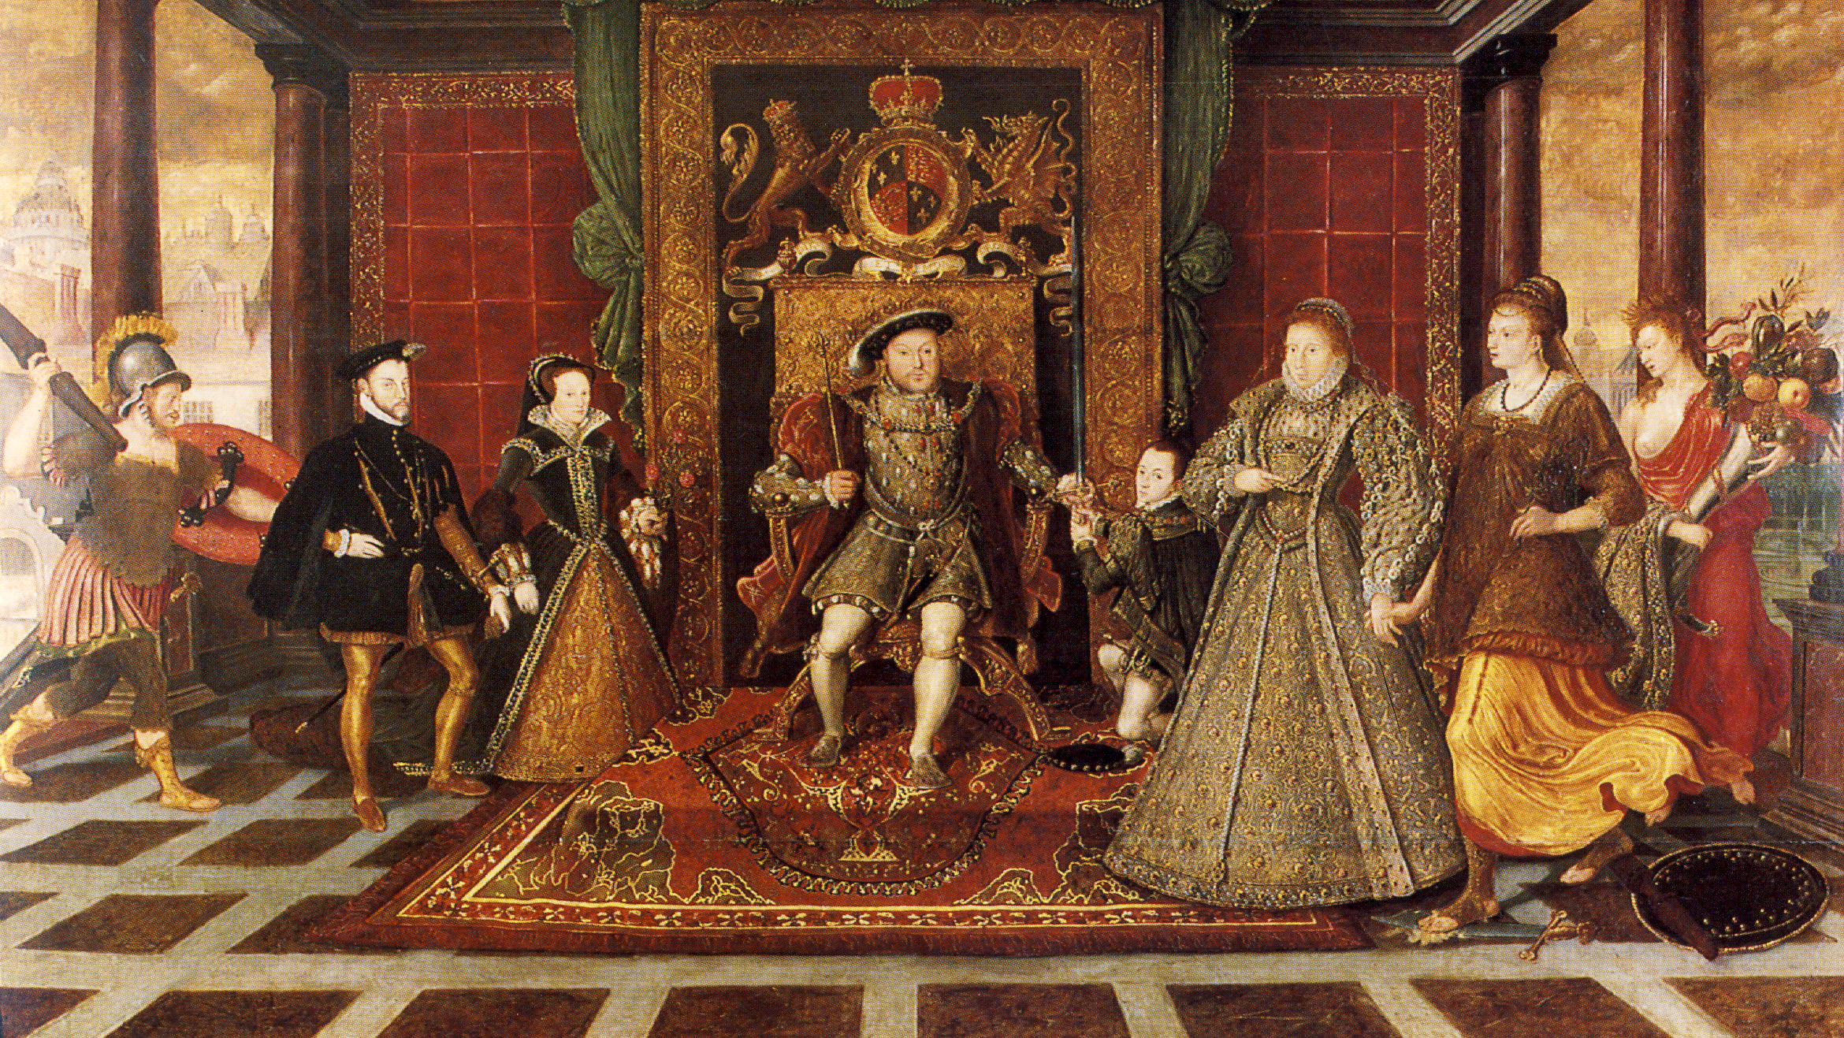
The Wives of Henry VIII
Tales of Loyalty and Tragedy in Tudor England
This Photo by Unknown Author is licensed under CC BY-SA
Notes:
In this presentation, we will explore the six wives of Henry VIII. We will delve into their lives and stories, and the role they played in the tumultuous history of England.

Slide 2
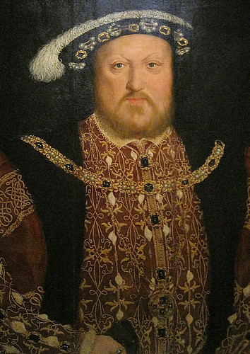
Presentation Overview
Introduction
A brief introduction to Henry VIII and the political context of his reign, exploring the events that led to his matrimonial affairs and the impact of his reign on English history.
Henry VIII's Wives
An exploration of Henry VIII's six wives, discussing their personalities, marriages, and ultimate fates, and the impact of their relationships on English history.
Impact on English History
A reflection on the impact of Henry VIII's matrimonial adventures on the course of English history, discussing the political, social, and cultural implications of his reign.
This Photo by Unknown Author is licensed under CC BY-SA-NC
Notes:
We will start with a brief introduction of Henry VIII and the political context of his reign. Then, we will explore each of his wives, discussing their personalities, marriages, and ultimate fates. Finally, we will reflect on the impact of Henry VIII's matrimonial adventures on the course of English history.

Slide 3
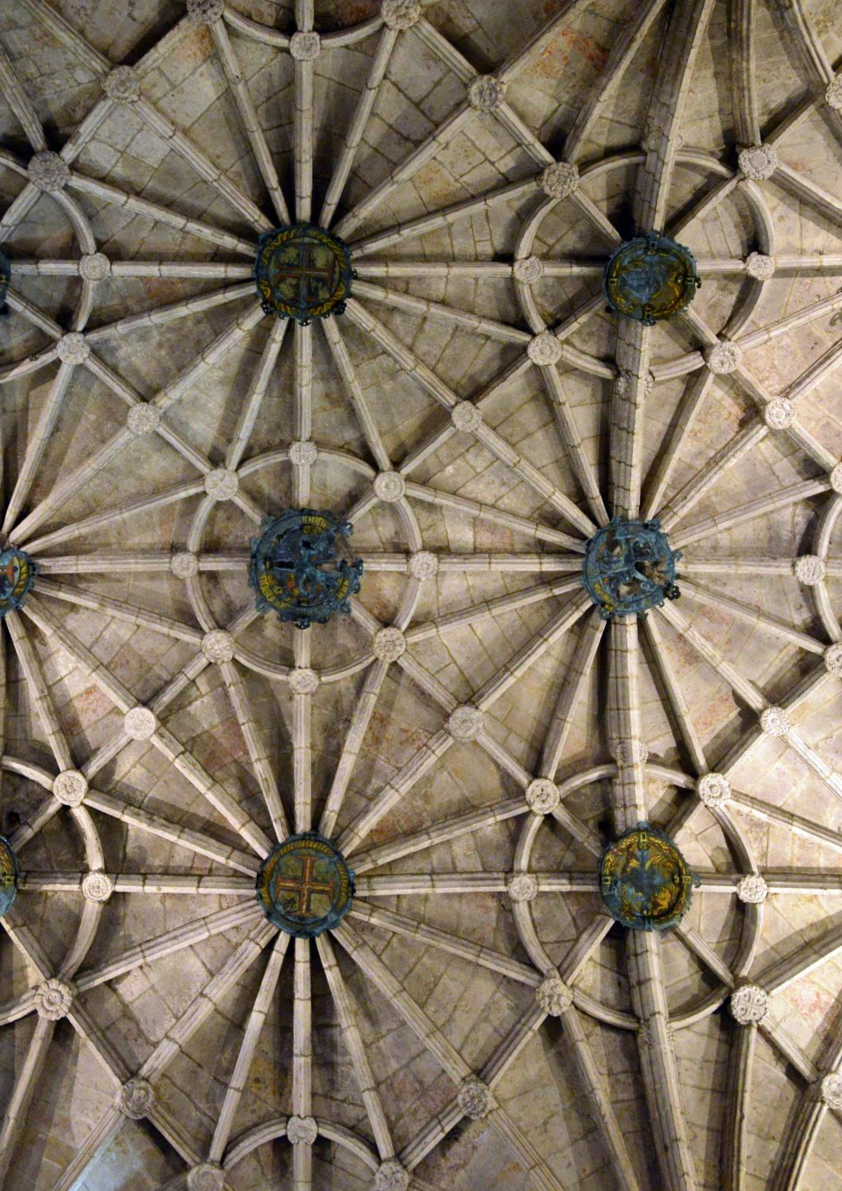
The Tudor Dynasty
The Tudor Dynasty
The Tudor dynasty ruled England from 1485 to 1603, and was marked by political and religious upheaval.
Henry VIII's Reign
Henry VIII's reign was marked by political and religious disputes, including the break with the Catholic Church and the establishment of the Church of England.
Political Landscape
The Tudor period was marked by political instability, with monarchs facing challenges from powerful nobles and foreign powers.
Religious Landscape
The Tudor period was marked by religious upheaval, including the break with the Catholic Church and the rise of Protestantism.
Notes:
Henry VIII was the second Tudor monarch, who ruled England from 1509 to 1547. The Tudor dynasty was marked by political and religious upheaval, and Henry VIII's reign was no exception. We will explore the political and religious landscape of the time, and the role that Henry VIII played in shaping it.

Slide 4
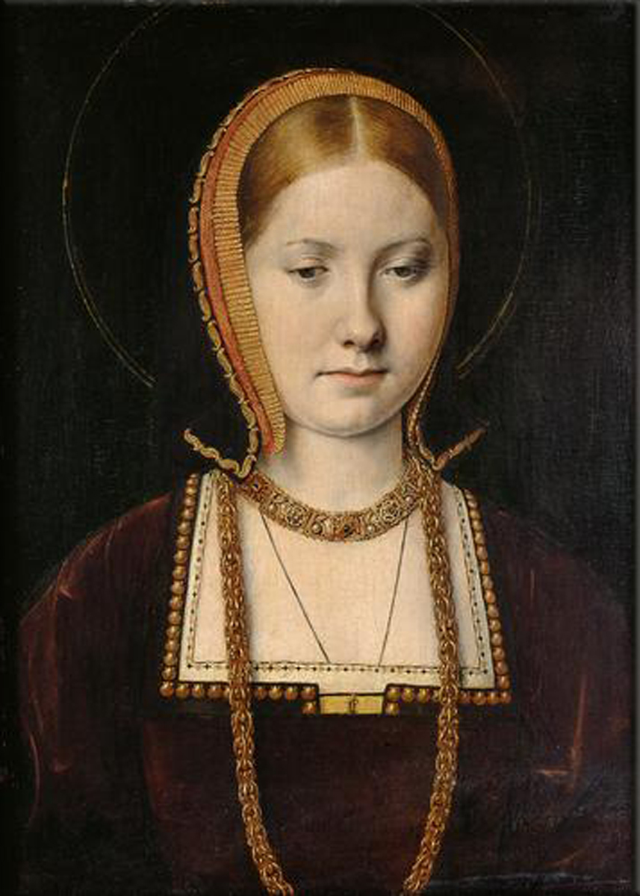
Catherine of Aragon
Catherine of Aragon's Life
Catherine of Aragon was born in Spain and became the first wife of Henry VIII, King of England. She was a devout Catholic and played a significant role in the politics of her time.
Catherine's Marriage to Henry VIII
Catherine was married to Henry VIII for over twenty years, but failed to produce a male heir, leading to his desire for a divorce and the eventual split from the Catholic Church.
The English Reformation
Henry VIII's desire for a divorce from Catherine of Aragon led to the English Reformation and the eventual split from the Catholic Church.
This Photo by Unknown Author is licensed under CC BY-NC-ND
Notes:
Catherine of Aragon was Henry VIII's first wife. She was married to Henry for over twenty years, but failed to produce a male heir. Henry's desire for a divorce led to the English Reformation and the eventual split from the Catholic Church. We will explore Catherine's life, her marriage to Henry, and the events that led to their divorce.

Slide 5
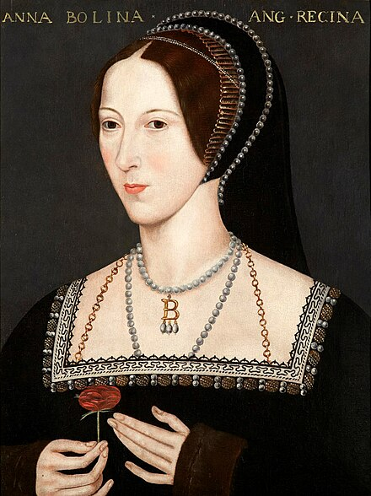
Anne Boleyn
Anne Boleyn's Life
Anne Boleyn was a controversial figure known for her intelligence, beauty, and wit. She was a key figure in the English Reformation and played an important role in Henry VIII's political and religious agenda.
Anne's Marriage to Henry VIII
Anne Boleyn's marriage to Henry VIII was a pivotal moment in English history. The marriage had significant political and religious implications, and marked a turning point in the English Reformation. However, it was also marked by controversy, political intrigue, and personal tragedy.
Anne's Downfall
Anne Boleyn was accused of adultery and treason, and was ultimately executed. Her downfall was the result of a combination of political, religious, and personal factors, and was a significant event in English history.
This Photo by Unknown Author is licensed under CC BY-SA
Notes:
Anne Boleyn was Henry VIII's second wife. She was a key figure in the English Reformation, and her marriage to Henry had significant political and religious implications. Anne was accused of adultery and treason, and was ultimately executed. We will examine Anne's life, her marriage to Henry, and the events that led to her downfall.

Slide 6
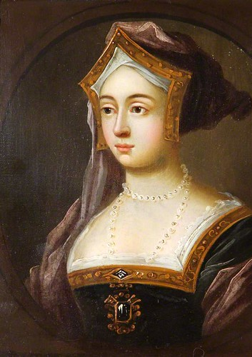
Jane Seymour
Jane Seymour's Life
Jane Seymour was born in 1508, came from a noble family and lived in Wiltshire, England. She was the third wife of King Henry VIII, and the only one to give birth to a surviving son. She died 12 days after giving birth to Edward VI due to complications from childbirth.
Jane Seymour's Marriage to Henry VIII
Jane Seymour married King Henry VIII in 1536, shortly after the execution of his second wife, Anne Boleyn. Jane was a gentle and kind woman, and Henry was deeply in love with her. Their marriage was short-lived, lasting only 1 year and 4 months.
Events Leading to Jane Seymour's Death
Jane Seymour's death was caused by complications from childbirth. After giving birth to Edward VI, Jane fell ill and died 12 days later. Her death was a tragedy for the Tudor dynasty, as Edward VI was the only surviving male heir of King Henry VIII.
Notes:
Jane Seymour was Henry VIII's third wife. She was the only wife to give birth to a surviving son, Edward VI. However, her life was cut short due to complications from childbirth. We will explore Jane's life, her marriage to Henry, and the events that led to her tragic death.

Slide 7
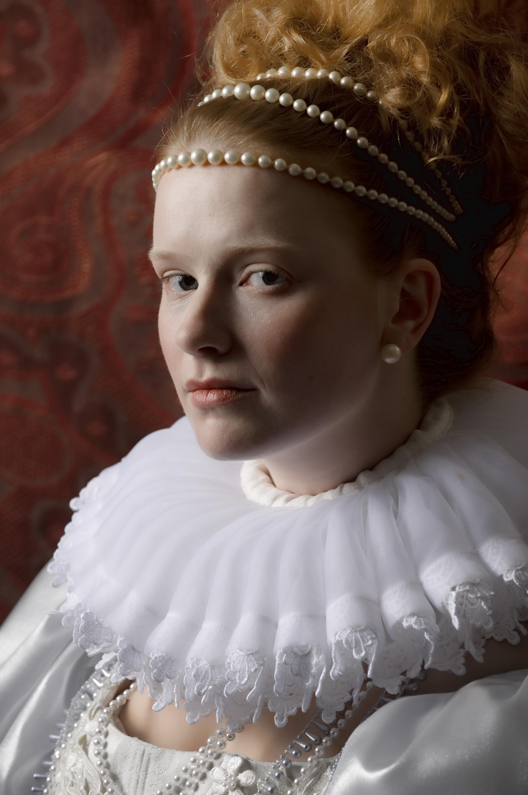
Anne of Cleves
Anne of Cleves's Life
Anne of Cleves was born in Germany and was a member of the Protestant nobility. She was chosen as Henry VIII's fourth wife when he was seeking a political alliance with the Protestant states in Germany.
Marriage to Henry VIII
Anne of Cleves's marriage to Henry VIII was arranged for political reasons, but Henry was disappointed with Anne's appearance and sought an annulment. The marriage was annulled after six months, but Anne managed to survive the marriage unscathed.
Notes:
Anne of Cleves was Henry VIII's fourth wife. The marriage was arranged for political reasons, but Henry was disappointed with Anne's appearance and sought an annulment. We will examine Anne's life, her brief marriage to Henry, and how she managed to survive the marriage unscathed.

Slide 8
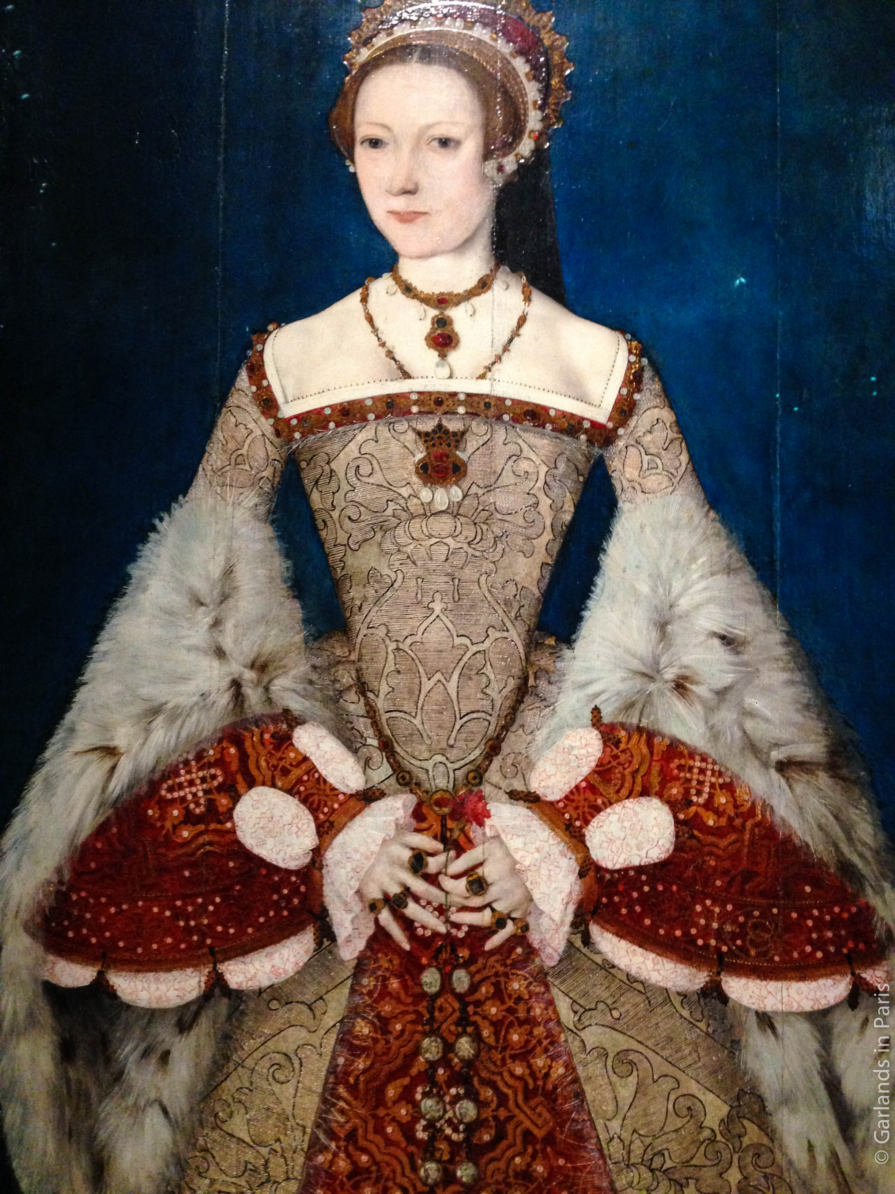
Catherine Parr
Marriage to Henry VIII
Catherine Parr was the sixth wife of King Henry VIII. Despite the challenges of her marriage, Catherine played an important role in promoting religious reform in England.
Promoting the English Reformation
Catherine Parr played an important role in promoting the English Reformation. She was a devout Protestant and used her position to promote religious reform in England.
Life after Henry VIII
After the death of Henry VIII, Catherine Parr went on to marry again and pursue a life of intellectual and religious pursuits. She wrote several books and was an important patron of the arts and sciences.
This Photo by Unknown Author is licensed under CC BY-SA-NC
Notes:
Catherine Parr was Henry VIII's sixth and final wife. She was a devout Protestant, and played a role in promoting the English Reformation. Catherine survived Henry, and went on to marry again and pursue a life of intellectual and religious pursuits. We will examine Catherine's life, her marriage to Henry, and her impact on English history.

Slide 9

The Legacy of Henry VIII
The English Reformation
The English Reformation was a series of events in 16th-century England that led to the creation of the Church of England and the break with the Catholic Church. Henry VIII played a key role in this process, and its consequences continue to be felt today.
The Church of England
The Church of England was created as a result of the English Reformation. It is the mother church of the Anglican Communion and has had a profound impact on English society and culture.
The Break with the Catholic Church
The break with the Catholic Church was a major turning point in English history. It led to the establishment of the Church of England, and marked the beginning of a new era in English politics, society, and culture.
Notes:
Henry VIII's matrimonial adventures had a profound impact on English history. The English Reformation, the creation of the Church of England, and the break with the Catholic Church all had far-reaching consequences. We will reflect on the legacy of Henry VIII, and the lessons that can be learned from his life and reign.

Slide 10

Conclusion
Unique Stories of Six Wives
Each of the six wives of Henry VIII had a unique story to tell, and exploring their lives and times gives us a deeper appreciation for the complexity and drama of Tudor England.
Impact on English History
The six wives of Henry VIII left their mark on English history, shaping the country's religious and political landscape and influencing the course of events for centuries to come.
Notes:
The six wives of Henry VIII were fascinating figures who left their mark on English history. From the devout Catherine of Aragon to the tragic Catherine Howard, each wife had a unique story to tell. By exploring their lives and times, we gain a deeper appreciation for the complexity and drama of Tudor England.

